Slide 1


Electric Car Website
Welcome to EL-Drive:
Your Destination for Electric Cars
Name: Yadav Rohit K.
Roll No: 225
Branch: CE
Enrollment No: 22002170110210

Slide 2
Why Electric Cars?
Enviroment Benefits
Energy
Efficiency
Technological
advancement
Economic Advantages

Slide 3
Sections
Home
Featured
About
offer
Super Cars
Footer

Slide 4
Languages
JS Libraries
HTML
Swiper.js
CSS
MixUp.js
Java Script
ScrollReveal.js

Slide 5
Features of Electric Cars
01
Charging infrastructure
Electric cars benefit from a growing network of charging stations, enabling drivers to recharge their vehicles conveniently
02
Eco-Friendly Materials And Design
Electric cars often feature eco-friendly materials and sustainable design elements to minimize their environmental footprint
03
Advanced Thermal Management Systems
Electric cars often incorporate sophisticated thermal management systems to regulate battery temperature and optimize performance, efficiency, and longevity.

Slide 6




Showcase Electric Car Models

Slide 7
Benefits for Consumers
Cost Savings
In addition to lower fuel costs, electric cars offer savings on maintenance expenses due to fewer moving parts and less frequent servicing requirements.
Convenience
Electric cars provide a convenient and hassle-free driving experience for consumers.
Enviromental Impact
By choosing electric cars, consumers can make a positive impact on the environment
Reduced Dependence Fossil Fules
By transitioning to electric cars, consumers can reduce their dependence on fossil fuels and contribute to the sustainability of the environment.

Slide 8
Sustainability And Environmental Impact
Conservation Of Resources
Environmental Benefits
Health Benefits
Renewable Energy Integration

Slide 9
Conclusion
“Join The Electric revolustion Today!”
Encourage viewers to take action and embrace electric cars as a part of the sustainable transportation revolution. Highlight the transformative potential of electric vehicles in creating a cleaner, greener future for all.
Invite viewers to be part of the electric revolution by considering electric cars for their next vehicle purchase or advocating for sustainable transportation policies in their communities. Empower them to make a positive difference through their consumer choices and advocacy efforts.

Slide 10
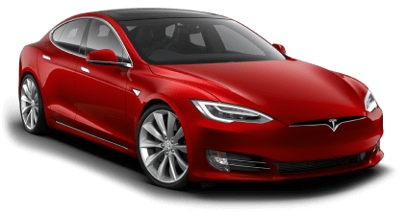
Tesla Model 3

Slide 11
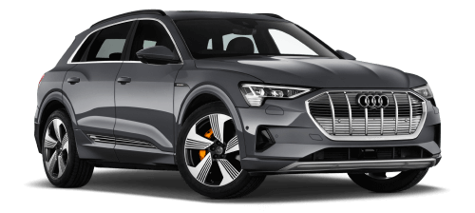
Audi E-Tron

Slide 12
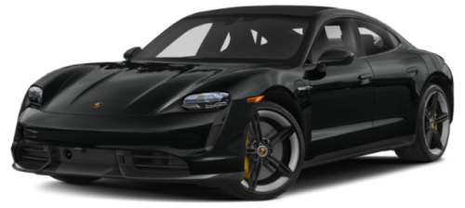
Porsche Turbo S

Slide 13
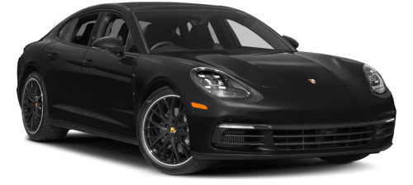
Porsche Panamera

